Slide 1



PROJECT TITLE: SPEECH RECOGNITION FOR COMPUTER INTERACTION WITH PHYSICALLY HANDICAPPED PEOPLE
DEPARTMENT OF COMPUTER SCIENCE AND ENGINEERING. 2019-2023
G. Hemanth Reddy (199P1A0514)
G. Sai Rani (199P1A0522)
Ch. Anand (199P1A0537)
U. Vivek (199P1A0536)

Slide 2
Introduction
Surfing the internet without a mouse and keyboard or an inability to use a touchscreen can be difficult, if not impossible. In this section, we will build a system to ease handicapped human-computer interaction with Speech recognition and Text-to-speech technology.
Speech recognition and Natural language processing can be used to detect and recognize voice input. Text output cannot be useful in all cases, hence Text-to-Speech technology can be used for providing output.

Slide 3
Problem Motivation
Neither arms nor eyes are necessary in human-machine communication. Both human and machine just speak and/or listen, or machine does it instead of people. Therefore, speech communication can help people who cannot use their arms or eyes. Apart from visually impaired, physically disabled, speech recognition technology can help the speech impaired and elderly people as well.

Slide 4
Objective
Our main motive behind Voice Input Detection and Recognition is enable the disabled community still strive to excel in the IT industry, especially when it comes to writing documents, programs or files on a computer, or in general, usage of computer to its fullest.

Slide 5
Existing System
Existing System involves usage of many virtual assistants to automate day-to-day activities. These include suggesting outfits and gadgets to carry out depending on weather conditions, setting a timer/alarm for an event on a particular date or reminder to not miss certain important tasks.
Most of these systems use the basic of all the models (i.e. HMM for speech Recognition). They mostly don’t involve computer interaction and don’t provide associated functionalities.

Slide 6
Proposed System
The proposed system is aimed to configure the system software using language bindings and provide a way to machine-human communication without having to explicitly depend on primitive input devices like keyboard/mouse.
User can interact with the computer by providing input through speech and receive feedback through the computer simulated human-audio.

Slide 7
Software & Hardware Requirements
Software Requirements
Operating system :Windows 10
Programming language : Python
Library Resources : Google’s SpeechRecognition API for python, pyttsx3 (python text to speech engine version 3), pyautogui, pywhatkit, python regex (re)
Hardware Requirements
A Laptop with in-built microphone and speakers
or
A PC with:
A dynamic microphone
A speaker (15-30 W)

Slide 8
Working
Steps involved:
Reading a File for Audio Signals
Transforming Audio Frequencies
Extracting Features from Speech
Recognizing Spoken Words
Feedback using tts(text-to-speech) engine

Slide 9
Implementation
Speech recognition can be generally done using these models:
Hidden Markov model (HMM)
CTC (Connectionist Temporal Classification) model
WaveNet model

Slide 10
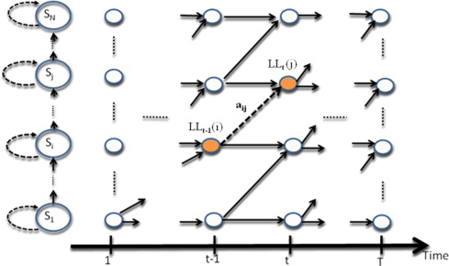
HMM model
It is the basic model used for speech recognition.
Highly Successful
Most Accurate
Ex: Google’s
SpeechRecognition
API

Slide 11
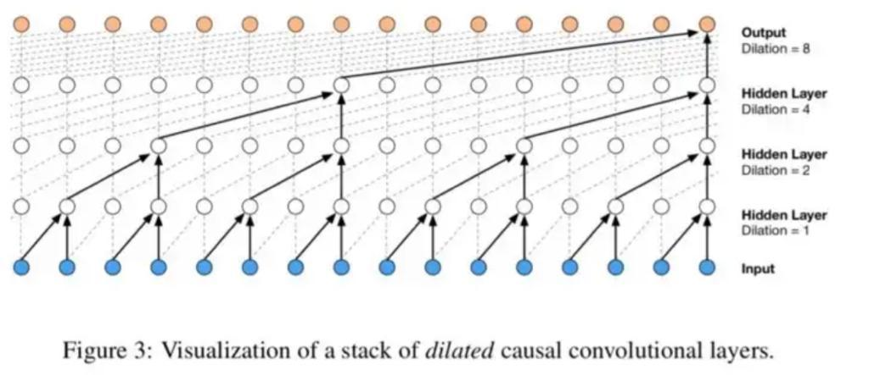
WaveNet model
It is developed using Deep Learning.
Uses Machine Learning to generate audio
Ex: Amazon Alexa

Slide 12
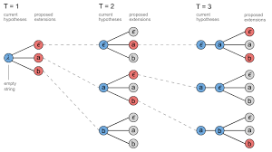
CTC model
It is one of the classical models used for speech recognition.
The algorithm is alignment-free.
It is faster to implement for large data.
Ex: Samsung Bixby, Sphinx

Slide 13
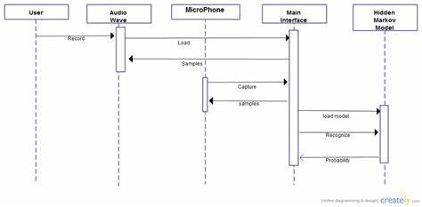
Architecture (UML diagrams)
Sequence Diagram:
Sequence Diagram is an interaction diagram that details how operations are carried out and illustrates the sequence of messages between objects

Slide 14
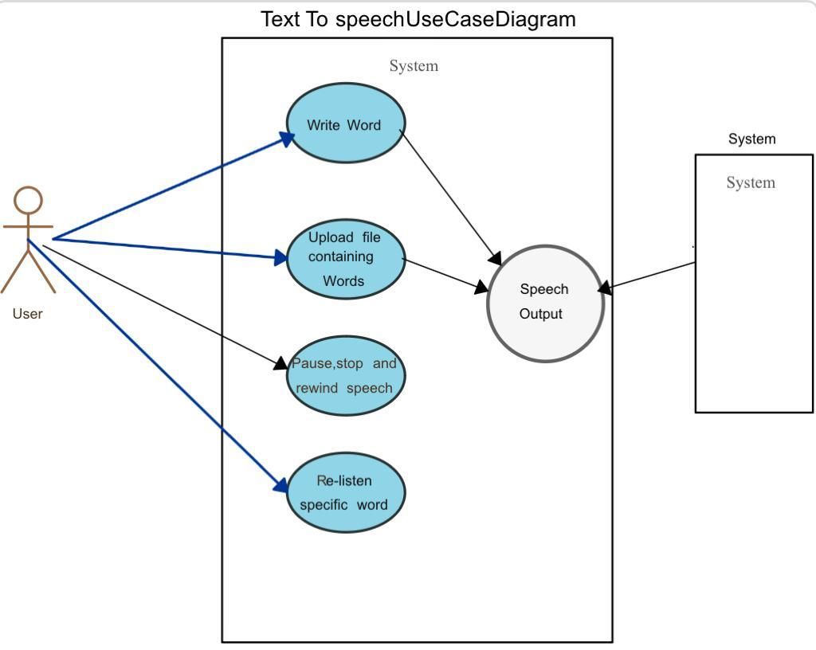
Architecture (UML diagrams)
Use case Diagram:
Use-case diagrams describe the high-level functions and scope of a system. They identify the interactions between the system and its actors. They describe what the system does and how the actors use it, but not how the system operates internally.

Slide 15
Conclusion
Speech Recognition and Text-to-speech technologies are currently booming in the Computer Science. Generally, visually impaired people have to use a separate script associated with them such as Braille script to write documents. Using this system, the need for such a script can be eliminated as they can communicate using voice commands.

Slide 16
Future Scope
The current system enables the computer to understand and simulate the human commands using a PC.
In future, the increasing advancement in the NLP domain may create a new model that is easy to work with all kinds of devices like Bluetooth headphones.

Slide 17
References
https://www.analyticsvidhya.com/blog/2018/08/google-cloud-text-to-speech-available/#:~:text=WaveNet%20is%20a%20model%20developed,hear%20in%20the%20Google%20Assistant.
https://www.rev.com/blog/transcription-blog/future-of-transcription-technology#:~:text=This%20model%20takes%20as%20input,being%20uttered%20in%20each%20frame.
https://www.tutorialspoint.com/artificial_intelligence_with_python/artificial_intelligence_with_python_speech_recognition.htm#:~:text=Recognition%20of%20Spoken%20Words&text=Pyaudio%20−%20It%20can%20be%20installed,-api-python-client.
https://realpython.com/python-speech-recognition/

Slide 18
Thank You 🙂

